Slide 1
The New Modern Application Platform Session 7: Helm Automation and Operators
“Bridging the growing chasm between developers and infra engineering”
Andy Tauber, Staff TAM
Dave Mazur, Staff TAM
January 2021

Slide 2
Today’s Class
What is Helm?
Helm basics
Operators
Helm Operators

Slide 3
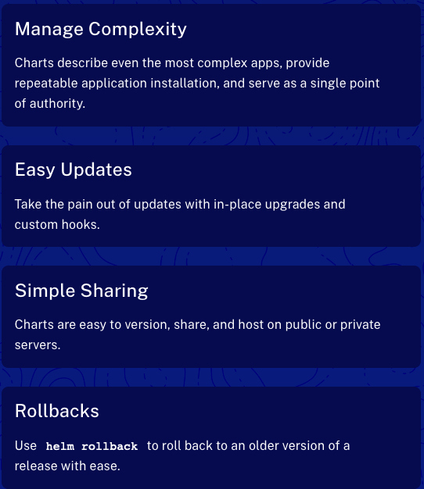
What is Helm?
Helm is THE Package Manager for Kubernetes
Helm helps you manage Kubernetes applications — Helm Charts help you define, install, and upgrade even the most complex Kubernetes application.
Charts are easy to create, version, share, and publish — so start using Helm and stop the copy-and-paste.
Helm is a graduated project in the CNCF and is maintained by the Helm community.
Notes:
https://helm.sh/

Slide 4
Helm Install and Demo
Quick demo to show you what it can do
Requires a Kubernetes cluster and kubectl (it installs on the currently configured Kube Config)
Mac install: brew install helm
Install the stable repo:
helm repo add stable https://charts.helm.sh/stable
helm repo list
helm search repo stable
Install a postgres DB
helm install mydb stable/postgresql
Note: read note about deprecation.
Install bitnami repo using instructions
Show possible values of postres chart
helm show values stable/postgresql
Notes:
https://helm.sh/docs/intro/quickstart/
https://helm.sh/docs/intro/install/

Slide 5
Helm Concepts
Chart / Repository / Release
A Chart is a Helm package. It contains all of the resource definitions necessary to run an application, tool, or service inside of a Kubernetes cluster.
A Repository is the place where charts can be collected and shared.
A Release is an instance of a chart running in a Kubernetes cluster. One chart can often be installed many times into the same cluster. And each time it is installed, a new release is created.
Notes:
https://helm.sh/docs/intro/using_helm/

Slide 6
Creating Helm Charts
Use to demonstrate Chart components
Create a default helm chart
helm create mySample
The “charts” folder is used for sub-charts
Review Chart.yaml
Name and Version are important!
Review values.yaml
Note the values that are set – especially “replicaCount”
The “templates” folder holds the yaml code to deploy the chart
Look at the deployment.yaml
Note the replicaCount substitution
Note the “includes” that are defined in _helpers.tpl
Note the “if” statement in ingress.yaml
Note the NOTES.txt which is what is displayed during the helm install
Notes:
https://helm.sh/docs/intro/using_helm/

Slide 7
Install postgres with a modified value
An example of two ways to install a chart with a modified value
Use an input file:
helm show values stable/postgresql > myInputFile.yaml
Edit myInputFile.yaml
Change service port from 5432 to 9950
Install: helm install -f myInputFile.yaml mydb stable/postgresql
Install with command line parameters
helm install --set service.port=9960 mydb stable/postgresql
Notes:
https://helm.sh/docs/intro/using_helm/

Slide 8
Helm Chart Library
https://artifacthub.io/
Find the Velero chart
Note the Install methods
Visit the readme.md link to go to: https://github.com/vmware-tanzu/helm-charts#kubernetes-helm-charts-for-vmware-tanzu
Visit the values.yaml file here: https://github.com/vmware-tanzu/helm-charts/blob/main/charts/velero/values.yaml
Note that helm charts may exist outside of the Chart Library. i.e. https://istio.io/latest/docs/setup/install/helm/
Notes:
https://artifacthub.io/

Slide 9
Operators
What is a Kubernetes Operator?
coreOS introduced Operators in 2016 to extend Kubernetes’ capabilities to stateful applications.
The Operator Framework: https://github.com/operator-framework
What is a Kubernetes Operator?
“An operator is a way of building an application and driving an application on top of Kubernetes, behind Kubernetes APIs. The idea is that when you have an application, like a database like Postgres or Cassandra…any complex application needs a lot of domain-specific knowledge,” Sebastien Pahl, director of engineering, Red Hat OpenShift, explained in a Kubecon 2018 presentation. You can use Kubernetes tools to try and solve some of those problems, he notes.
“But in the end, when it comes to really fully automating an application, and by fully automating, I mean handling updates from one version to another without waking people up, handling failure recovery if it’s needed, scaling the application up and down depending on some scenarios – all of that should be handled automatically,” Pahl says. “Humans should not be involved in this kind of operation because it kind of breaks the promise that containers gave us. Containers’ promise was ‘Hey, you package it once, it runs everywhere.’ Well, that’s true for developers, but in production, there’s so much more that needs to be done.”
Notes:
https://enterprisersproject.com/article/2019/2/kubernetes-operators-plain-English
Example of mongo pod initialization or connection to MongoDB enterprise services

Slide 10
Operator Repo
https://operatorhub.io/
Use Istio Operator for an example: https://operatorhub.io/operator/istio
14 helm subcharts
50+ CRDs
Without the operator, what is the proper upgrade order?
Istio Operator documentation: https://github.com/banzaicloud/istio-operator/blob/release-1.1/README.md
Note the helm install method – one command
Upgrading with the Istio Operator: https://github.com/banzaicloud/istio-operator/blob/release-1.1/docs/upgrade.md
Deploy a version of the operator which supports Istio 1.1.x
Apply a Custom Resource using Istio 1.1.14 components
What happens is that once the operator discerns that the Custom Resource it's watching has changed, it reconciles all Istio-related components in order to perform a control plane upgrade.
Notes:
https://enterprisersproject.com/article/2019/2/kubernetes-operators-plain-English
Example of mongo pod initialization or connection to MongoDB enterprise services

Slide 11
Prometheus Operator Demo
https://github.com/prometheus-operator/kube-prometheus
Prometheus is the vROPs of the K8s world.
This demo installs:
Prometheus Operator
Prometheus
Alertmanager
Prometheus node-exporter
Prometheus Adapter for Kubernetes Metrics APIs
Kube-state-metrics
Grafana
Note the new ”kind” of prometheus and alertmanager
Notes:
https://enterprisersproject.com/article/2019/2/kubernetes-operators-plain-English
Example of mongo pod initialization or connection to MongoDB enterprise services

